Slide 1
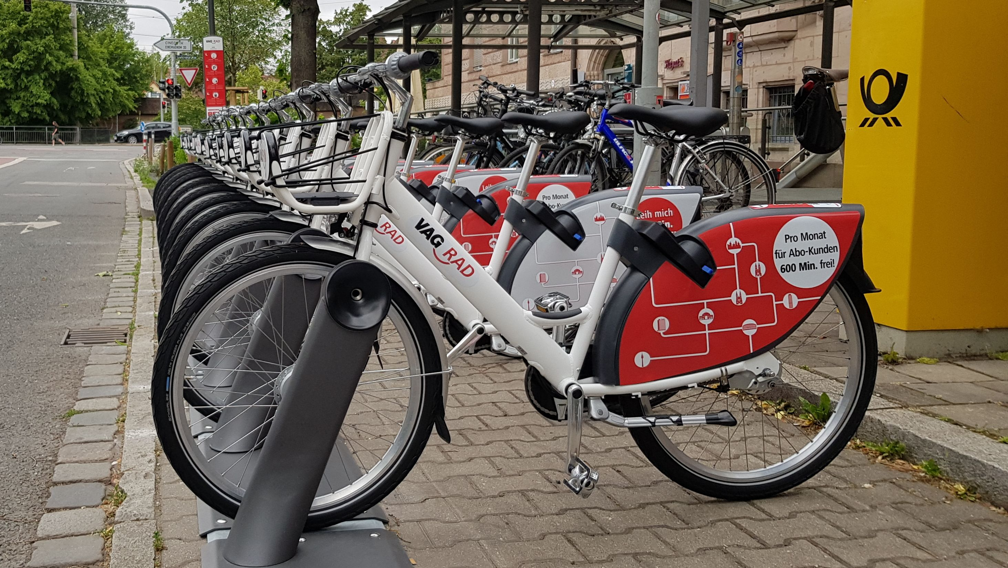
Nextbike Nuremberg
Michael Ulko, Max Strohbücker, Kevin Weiß, Jan Niklas Best
https://img.br.de/332a0000-8a22-4382-9224-bd58d6772321.jpeg?q=80&rect=1105,310,2927,1650
Economics and Social Science | Programming Data Science | 10.06.2020

Slide 2

Agenda
Visualizations
Interactive Maps
Geek Knowledge
Difficulties
Prediction Outcome
Future Improvements
Interesting Facts

Slide 3

GIT Facts
60 merged Pull requests
350 commits
42 branches
73 issues
11 unique visitors

Slide 4

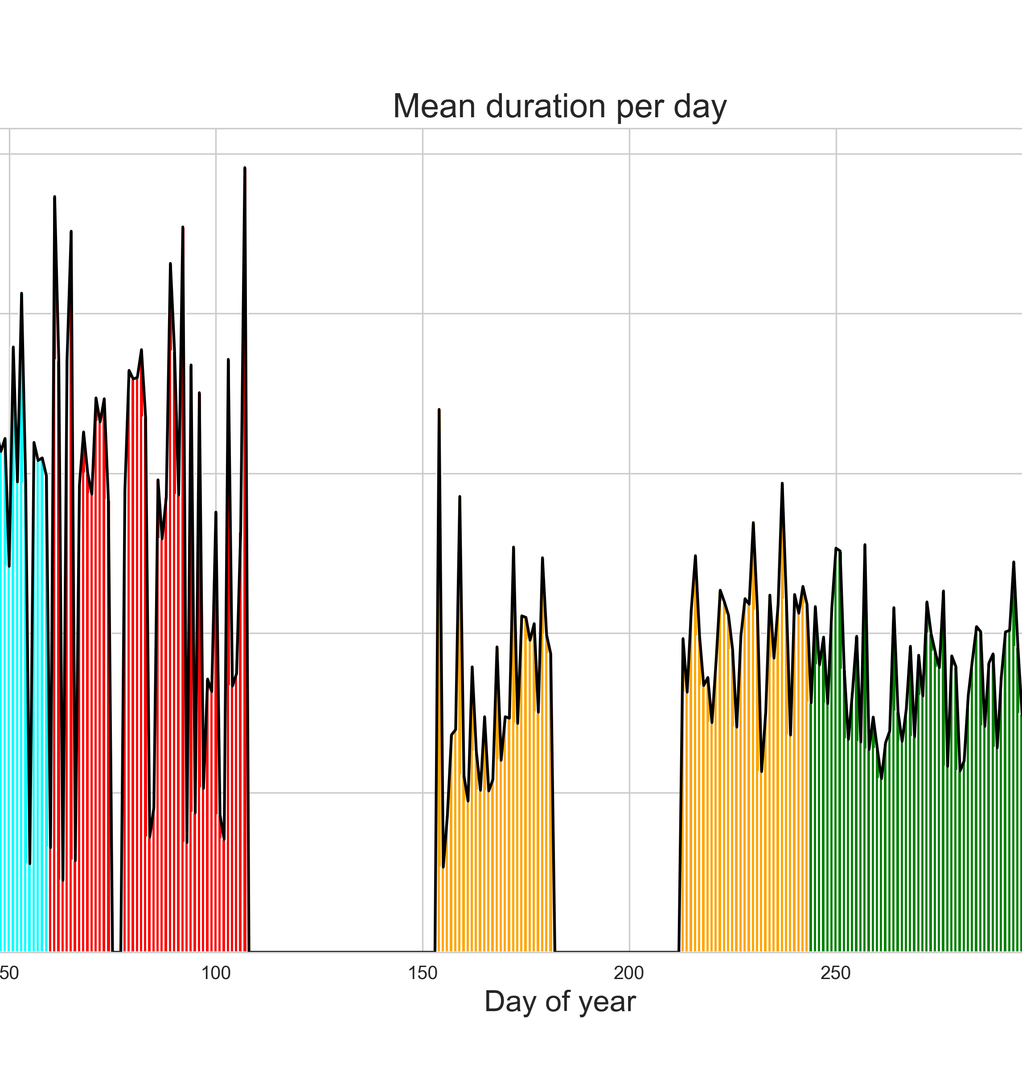
Interesting Facts in Data Exploration
missing data for May and July
data from Marburg
data reveals issues in 2019
service provider changed
technical problems in bike rental process in the beginning of 2019
most trips take place in the afternoon
30 % towards university
available Bikes: 602
≈ 2.275.089 data points
≈ 185.000 valid trips

Slide 5
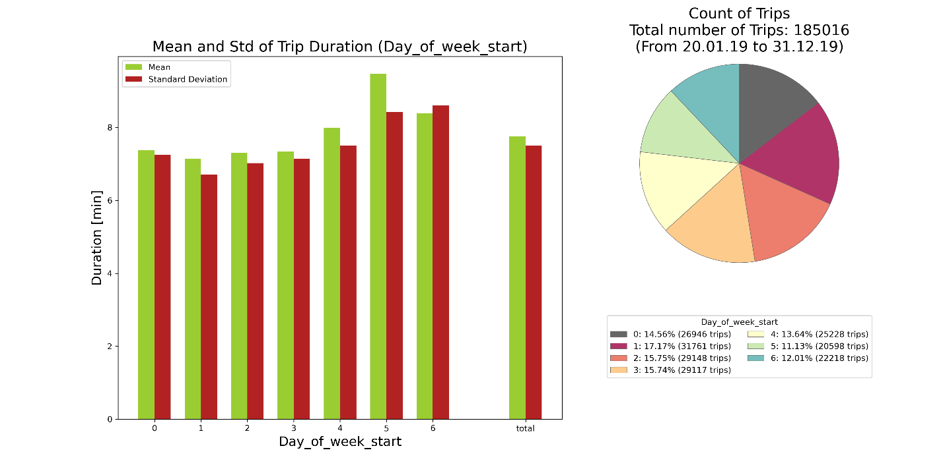
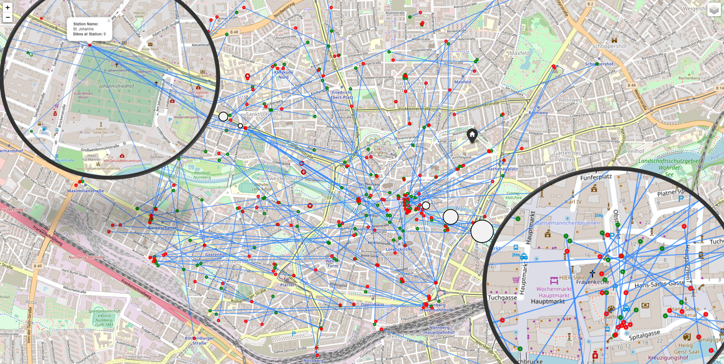
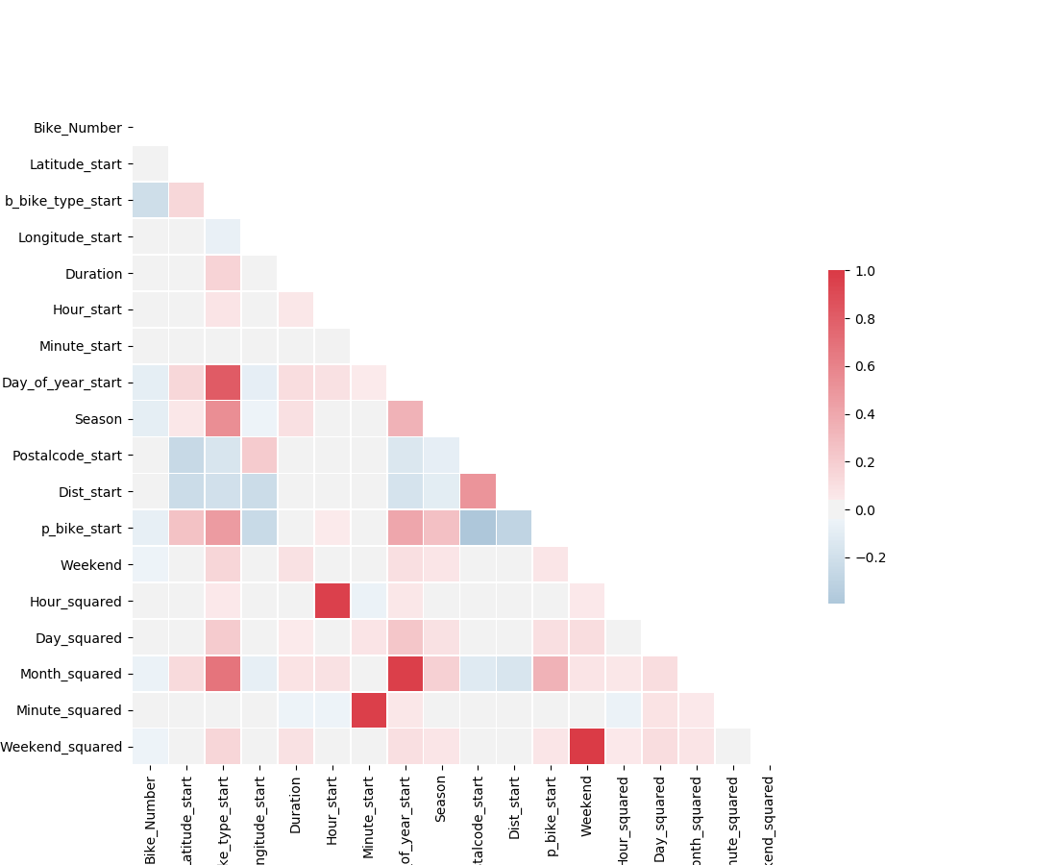
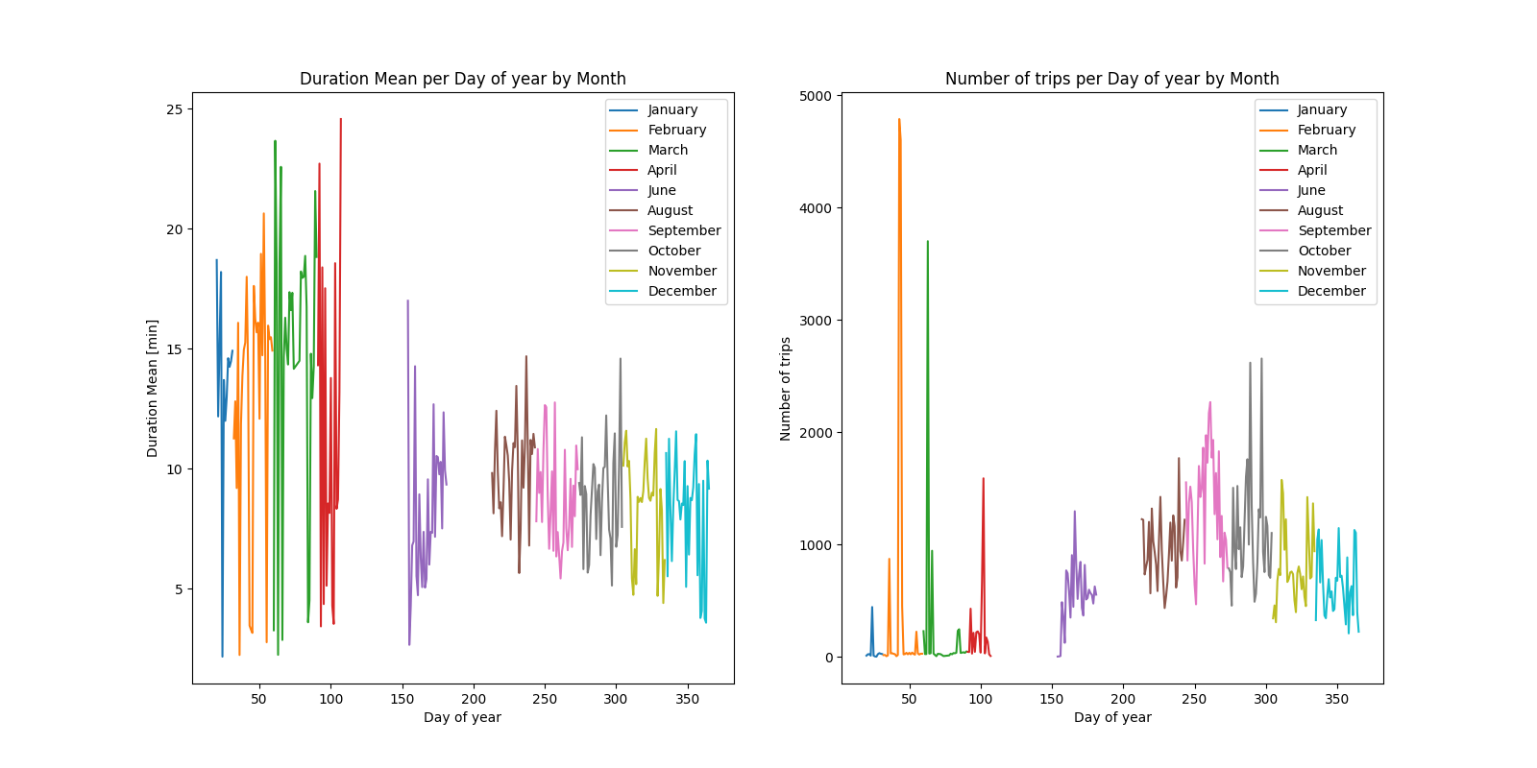
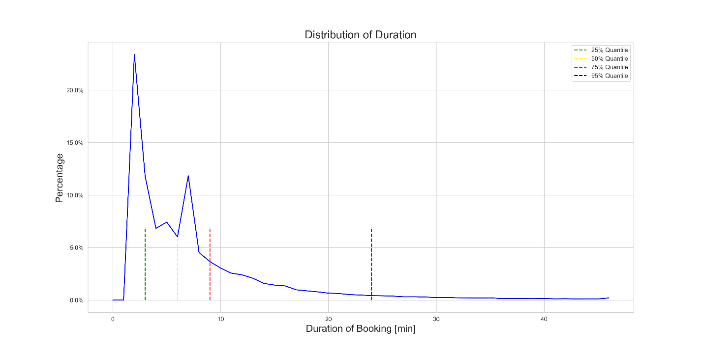
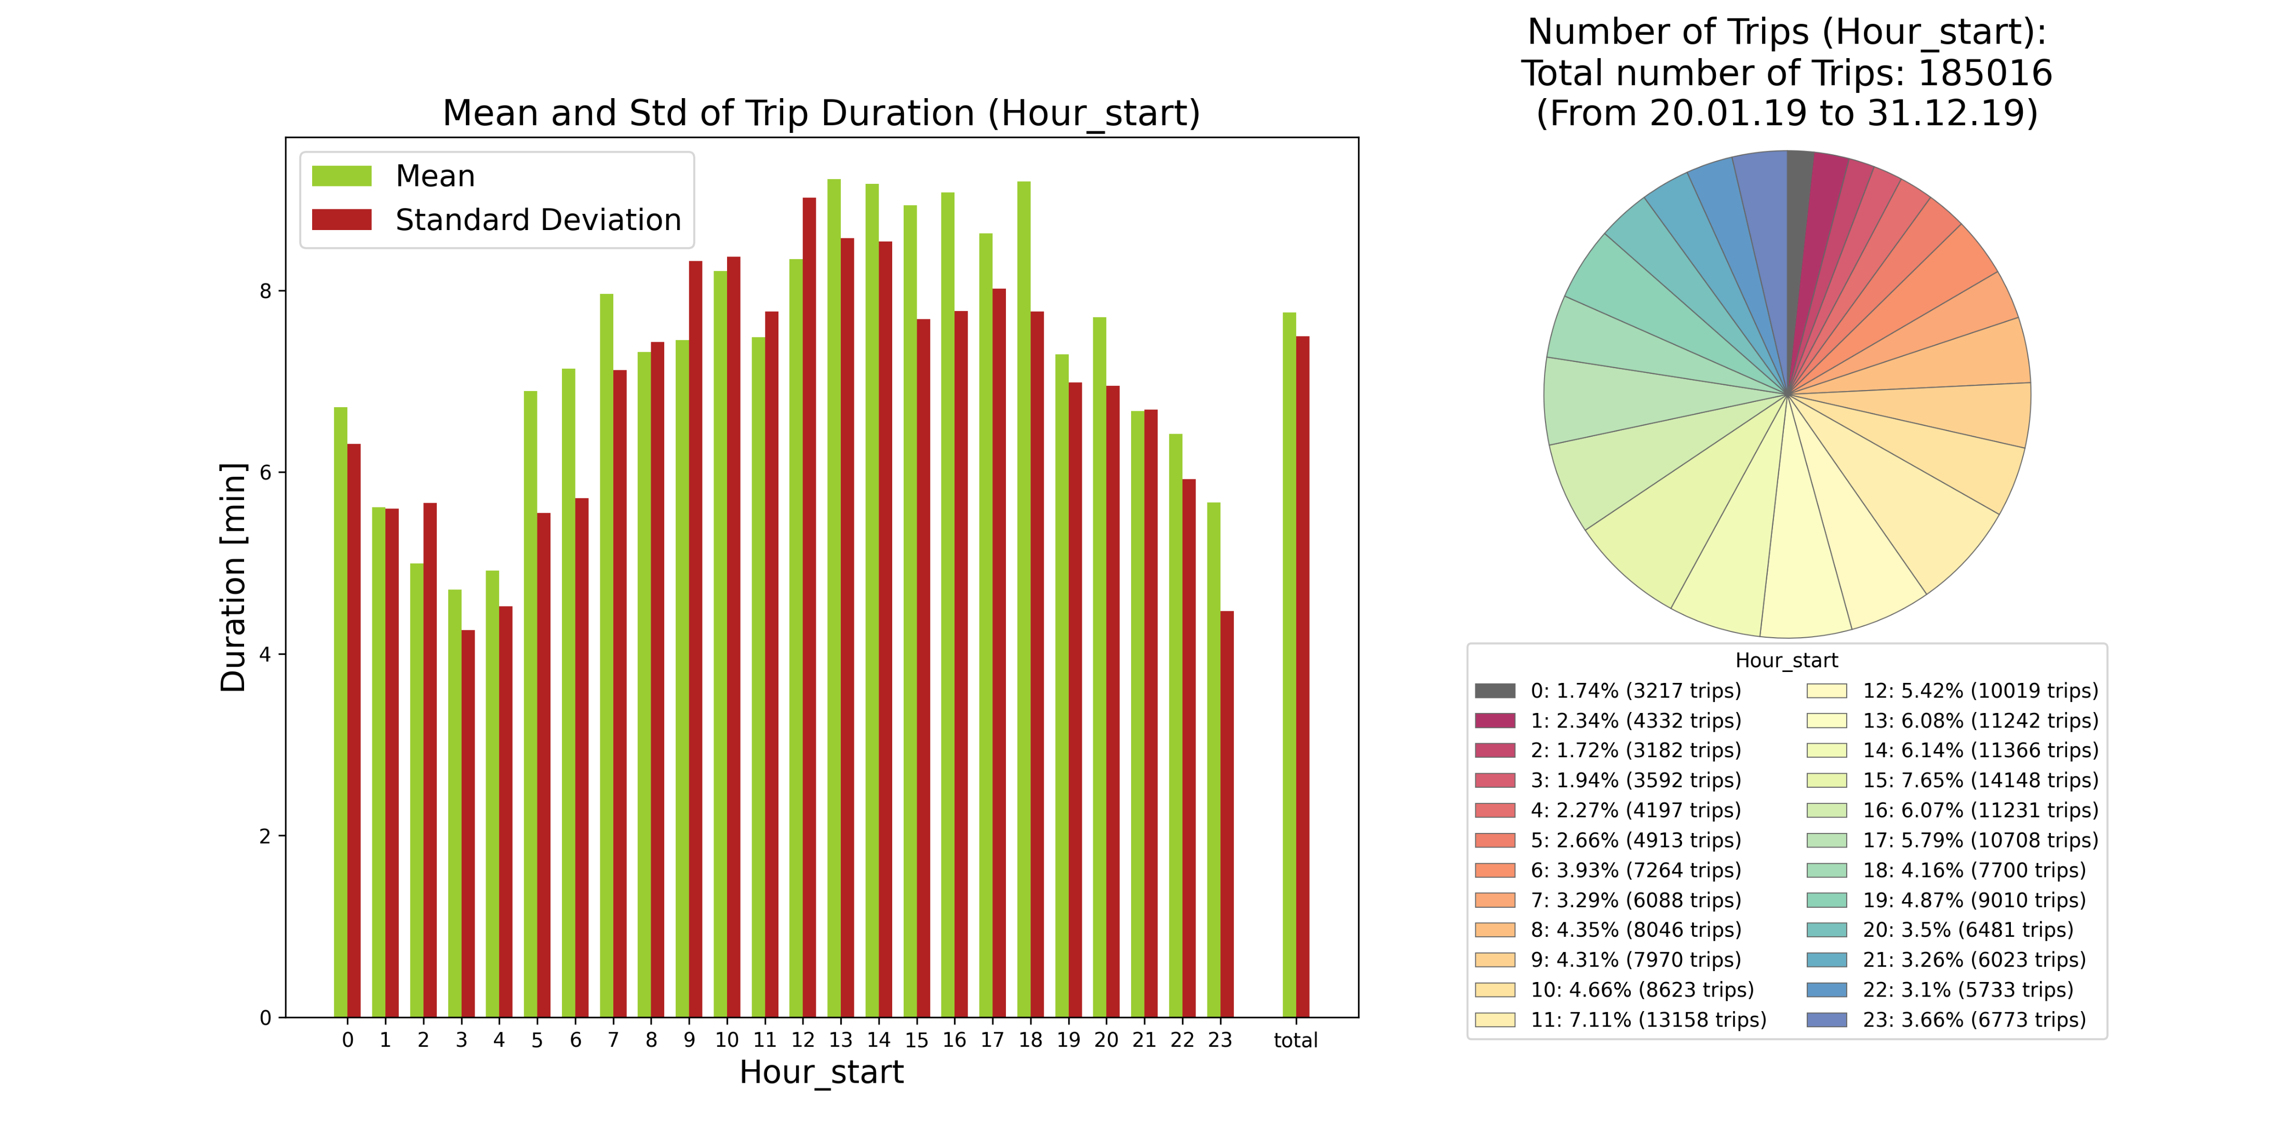
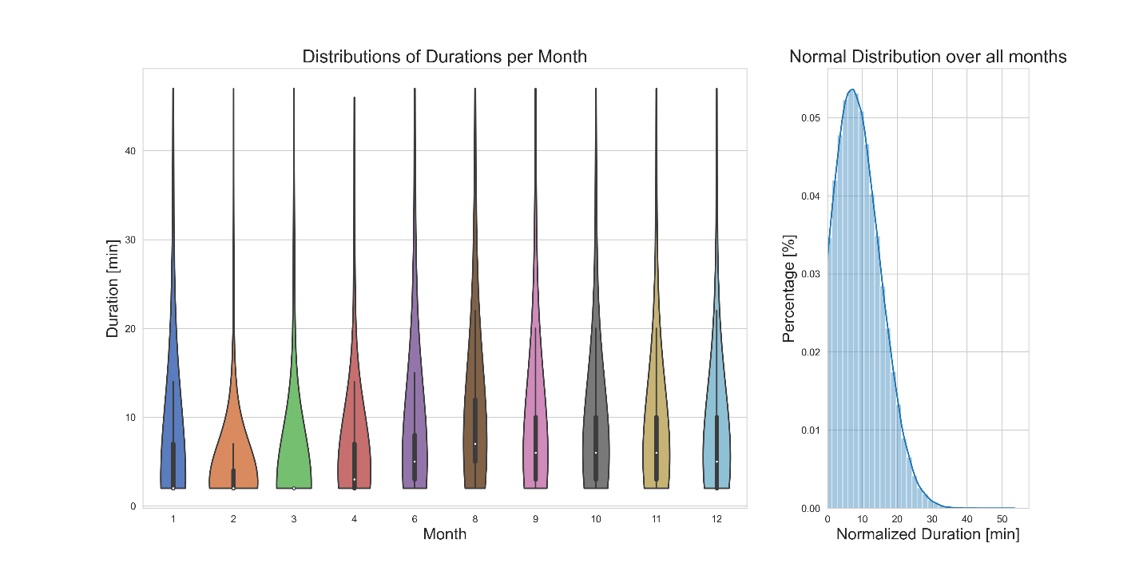
Some Visualizations
Notes:
Mean Grafik:
Mean as big as standard deviation
Weekend: fewer trips than during the week
Assumption: More business trips than private tours (students)
Verteilung
Fact, 75 % less than 10 minutes
Assumption: practmatical use of bikes rentals
Number of trips per day:
Not possibility, whether they are valid data
Weekend vs Weekday

Slide 6

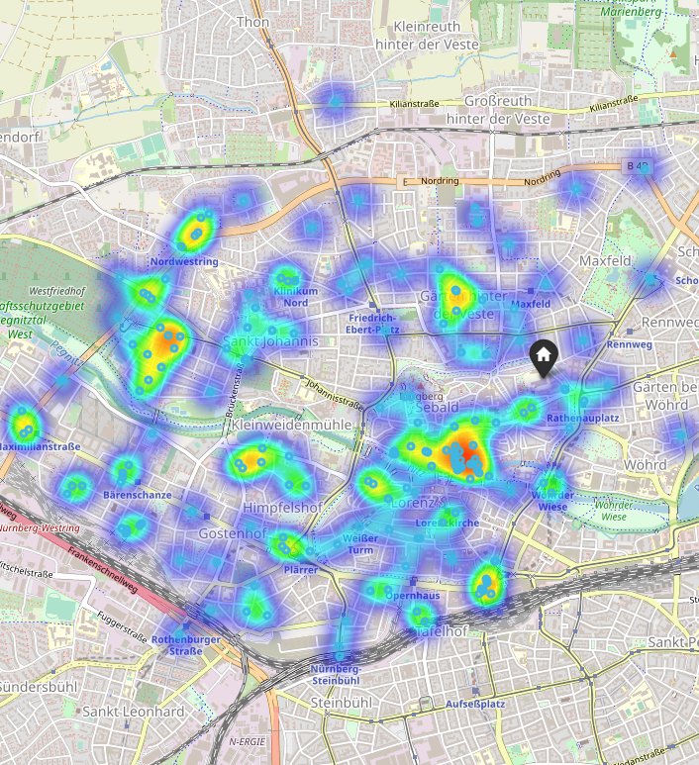
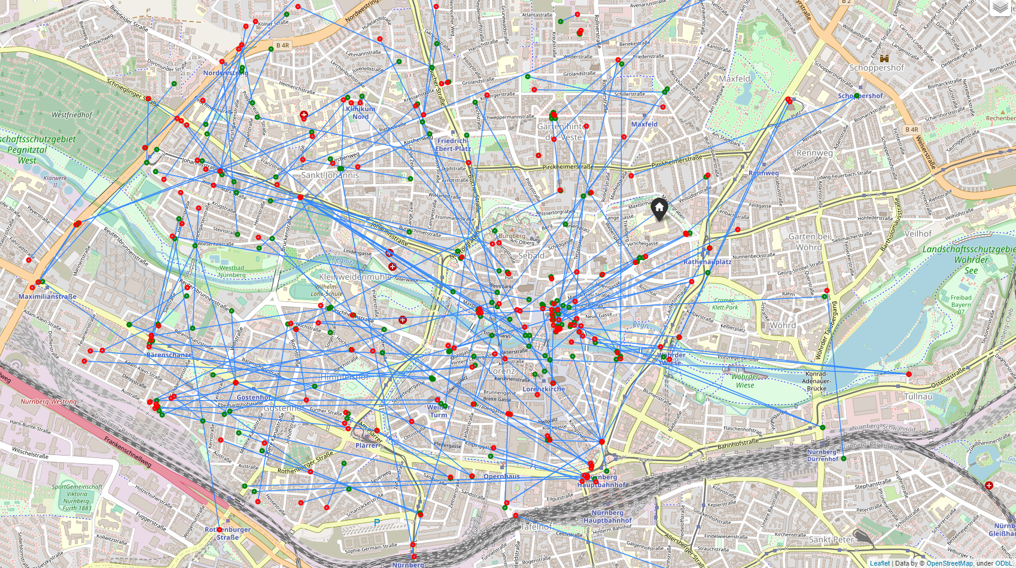
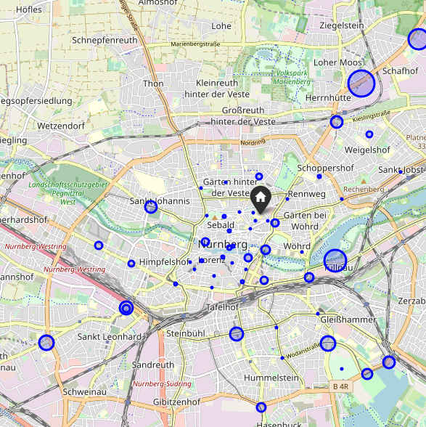
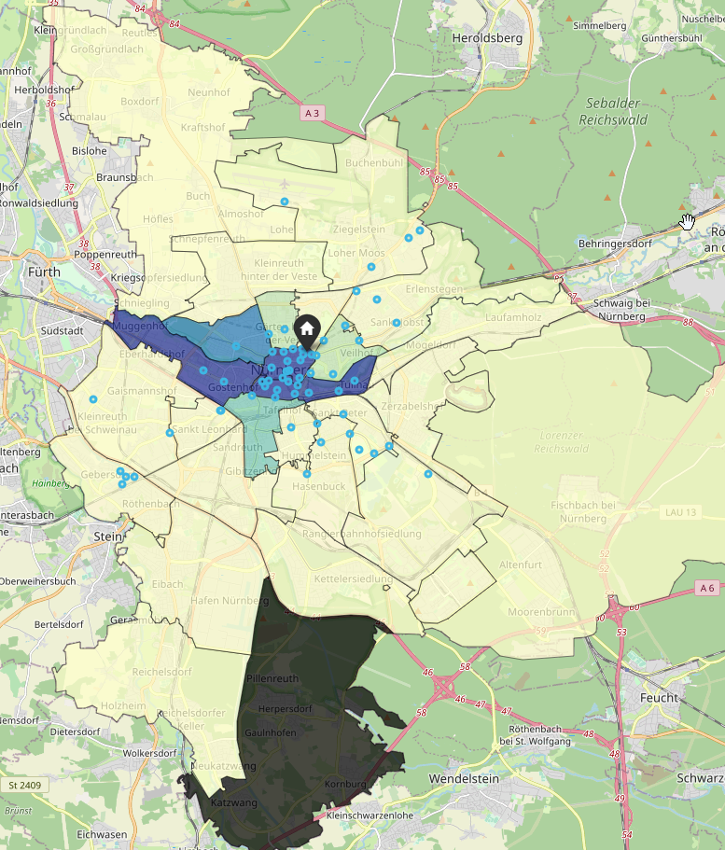
Live-Demo in the Maps
Notes:
Circle Marker stations + Uni
One moment in time (01.10.2019 08:00)
Circles show amount of available bikes
Home Icon is the university
PLZ
University
Trips stated in August (the month with the most trips in summer
More purple a postal code is, the more trips started there
Circles are fixed stations
City Center: free floating bikes without stations
Heatmap
December 24th
three points of interest
Without data: Univeristy
church: / Christmas market
graveyard
Trips
Green: started trips
Red: ended trips

Slide 7
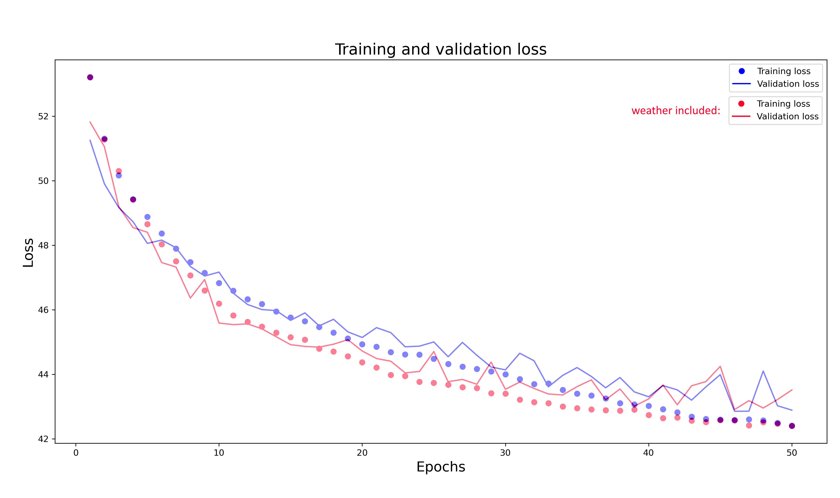
Geek Knowledge
Neural Network (NN) was best model
weather vs no weather
Support Vector Machine (SVM)
has long duration for valid results
Polynomial kernel
Degree = 3
Dummy Regression Median:
Most primitive algorithm for testing
Notes:
Regression on duration to predict how long bike is booked
-> How long no other customer can book it
-> possible cashflow
- Learning rate: not to hugh jumps but also less local minimums
Assumption: Weather generates performance
- weather equal at about 50 epochs
-> effort to gather future data + data quality
- dummy to validate others'
-> outperformed

Slide 8
Regression Outcome Duration Prediction
RMSE (≈) | MAE (≈) | R² (≈)
6.5103 | 3.9796 | 0.2411
Compared to std (7.4942) → ☺
Compared to mean (7.7569) → ☹
Notes:
Low errors because cleaning
-> focus on the main customer group
-> does not make sense to accept bad model performance
MAE
=>over- or underestimate 4 min
===> less that std in data
===>but half of mean
-----------> most of trips durations only 4 min away from real
RMSE
=>high weight on large errors
===> large errors in prediction
R^2
=> 25% of variance
===>75% of variance unexplained (missing features)
Fit to data (do not overfit) but cannot explain dependent variable

Slide 9
Geek Knowldge
Trips towards University | Trips away from University
53.691 (29.02%) | 131.325 (70.98%)
NN Classifier was best model
Brute force test on 640 different possible hyperparameter in models
Dummy (Most frequent)
Notes:
Classification predict trip direction from central city point
=> city of students
======> customer demand
NN better than KN, Random Forest, Decision Tree
Brute force over night
Outperform dummy (all false)

Slide 10
Classification Outcome Direction Prediction
Confusion Matrix |  | Predicted
 |  | Positive | Negative
Actual | Positive | (TP) 8.508 | (FN) 7.531
 | Negative | (FP) 3.950 | (TN) 35.516
Accuracy:
79.31% → 😐
Precision
68.29 %
Recall
53.04 % → ☹
Notes:
Accuracy = correct classified directions
TP+TN / All
=> 10% more than dummy
Precision = correct to university
TP / (TP+FP)
=> 30% to uni and 70% classfied as it
Recall: actual to university and as such classified
TP / (TP+FN)
=> lot of trips classified as not going to uni but actually do
=> Why? Max

Slide 11
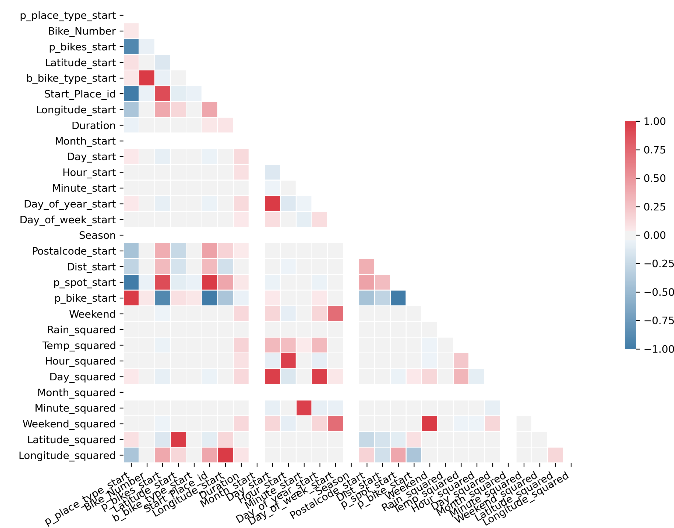
Difficulties that occurred
missing data
redundant data
noisy data
huge loss of data
trips to Fuerth
corrupted bookings
features
not enough explanatory power to predict duration
include user data
Notes:
Missing data
May +July was missing
redundant data
Noisy
Huge loss of data
Trips to Fürth
corrupted bookings
Features
Not enough explanatory power to predict duration
Include User data
Subscription Model
User ID
Business User

Slide 12

Future Research
collecting more data
feature analysis
use of spatial data
more business insides
expert background knowledge
exhaustive hyperparameter fitting
more computer power
ensemble methods
Classification of trip types or clustering of customers before regression analysis
AIC & BIC for feature selection
https://www.pngguru.com/free-transparent-background-png-clipart-nanay
Notes:
NIKLAS
Collecting data: From years
feature analysis: deepen the analysis to combine find further relations between variables and predict them more accurate.
Spatial data
Poulation density
More Weather data
Business insides
Create connections betwens actions or real news and relate them to the data
Create actions out of the information
To find the best hyperparamter, fitting for this model, more computing power would be smart
KEVIN
Stumble over AIC & BIC
=> best regression model with perfect number of parameters
=> use it to penalyze big models (17 components of pca)

Slide 13

Thank you for your attention

Slide 14

Backup

Slide 15
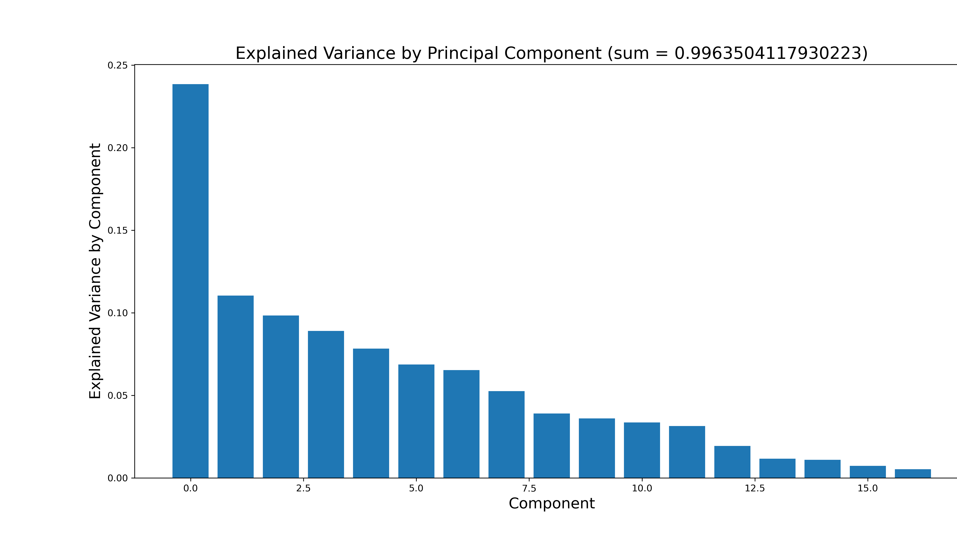

Slide 16
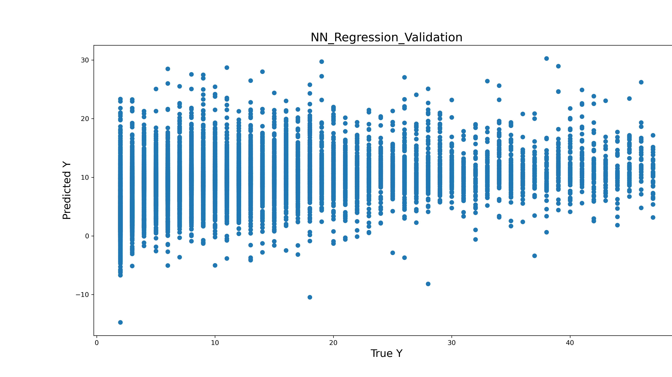

Slide 17
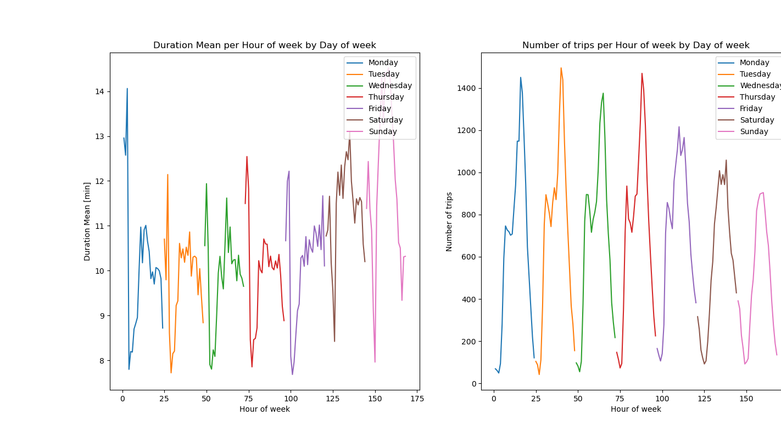

Slide 18


Slide 19
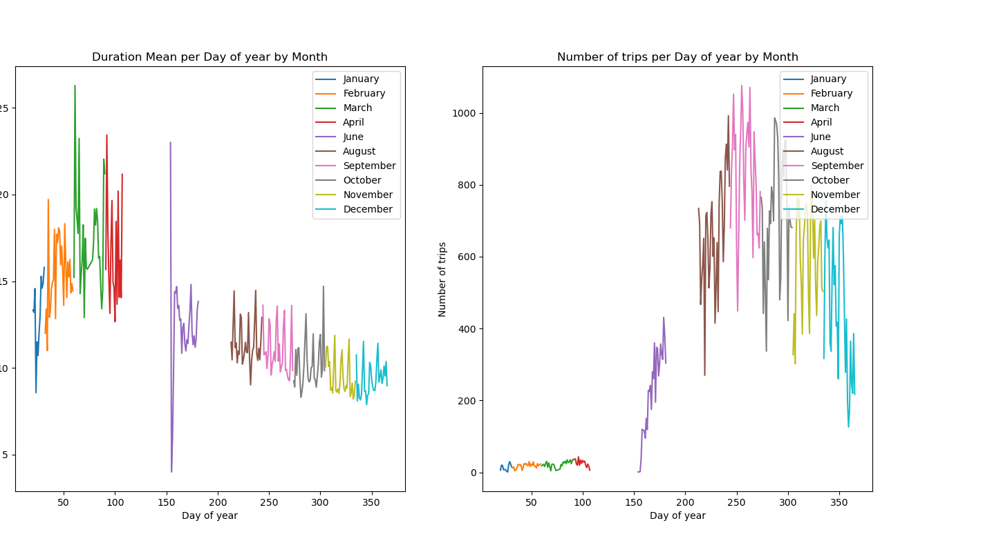

Slide 20
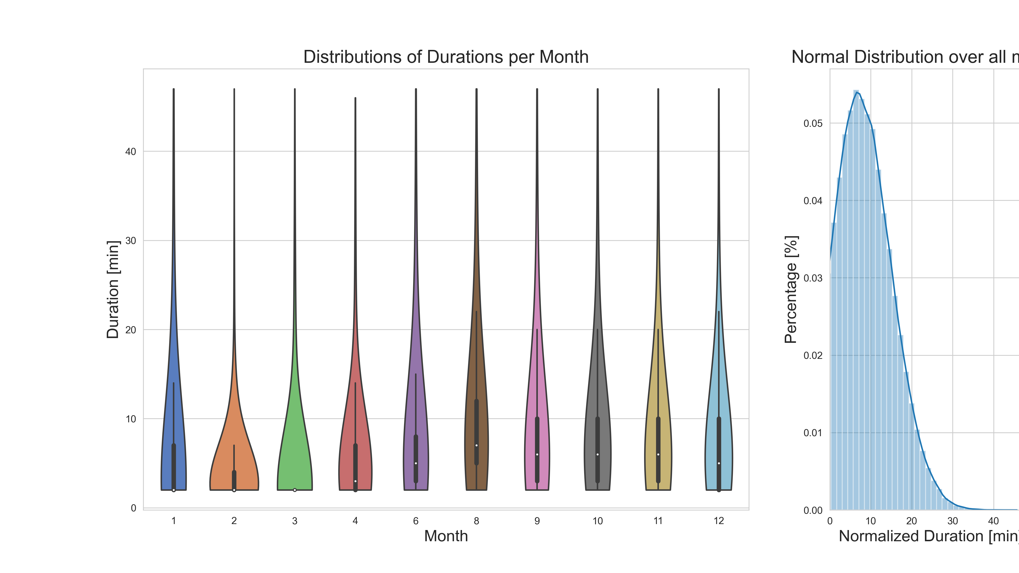

Slide 21
